Slide 1
Office of Research Compliance
The Office of Research Compliance has adapted the Vermont University controlled substances training with permission (2024)

Slide 2
Controlled Substances Act (CSA)
  Title II of the Comprehensive Drug Abuse Prevention and Control Act of 1970 is the United States drug policy by which the manufacture, possession, use and distribution of certain narcotics, stimulants, depressants, hallucinogens, anabolic steroids and other chemicals is regulated

Slide 3
Controlled Substances
  A controlled substance is a drug or chemical whose manufacture, possession, storage, use or disposal is regulated by the Drug Enforcement Administration (DEA)
  Included are all chemical substances in Schedules I-V of the Controlled Substances Act and any listed in the state laws of New York

Slide 4
Controlled Substances
  Placement of a controlled substance into one of the five Schedules is based on the following:
  - Medical use
  - Potential for abuse
  Psychological or physiological dependence
  Since 1970, many substances have been added, removed, or transferred from one schedule to another. An updated list of the schedules is published annually in Title 21 Code of Federal Regulations (CFR) 1308.11-1308.15

Slide 5
Controlled Substances
  Before ordering controlled substances, each Principal Investigator must have a license/registration from:
  - Bureau of Narcotic Enforcement (BNE)
  Drug Enforcement Administration (DEA)
  NOTE: The Drug Enforcement Administration is a law enforcement agency and can prosecute violators of the Controlled Substances Act

Slide 6
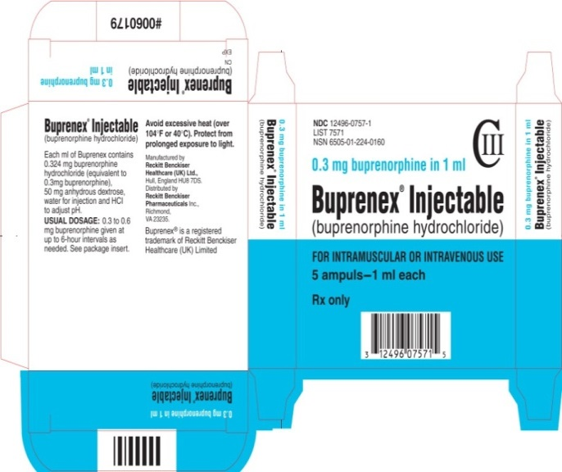
Controlled Substances
You can check whether the substance is a controlled substance by looking on the box. Often there is a capital “C” and roman numerals on the original packaging.

Slide 7
Schedule I Controlled Substances
No currently accepted medical use in the United States, a lack of accepted safety for use under medical supervision, and a high potential for abuse
Examples include:
Heroin
Lysergic acid diethylamide (LSD)
Marijuana (cannabis)
Peyote
Methaqualone
3,4-methylenedioxymethamphetamine (“Ecstasy”)

Slide 8
Schedule II/IIN Controlled Substances
High potential for abuse which may lead to severe psychological or physical dependence. Examples include:
Methadone
Oxycodone
Fentanyl
Morphine
Opium
Codeine
Cocaine
Methamphetamine

Slide 9
Schedule III/IIIN Controlled Substances
Potential for abuse is less then substances in Schedules I or II and abuse may lead to moderate or low physical or high psychological dependence. Examples include:
Benzphetamine
Phendimetrazine
Ketamine
Anabolic steroids

Slide 10
Schedule IV Controlled Substances
Low potential for abuse relative to substances in Schedule III. Examples include:
Alprazolam
Carisoprodol
Clonazepam
Clorazepate
Diazepam
Lorazepam
Midazolam
Temazepam

Slide 11
Schedule V Controlled Substances
Low potential for abuse relative to substances in Schedule IV and contain preparations containing limited quantities of certain narcotics. Examples include:
Ezogavine
Lomotil
Motofen
Lyrica
Parepectolin
Cough preparatons (Robitussin AC, Phenerganwith Codeine)

Slide 12
Investigator Responsibilities
  Each person who orders, handles, or stores controlled substances must be registered with the DEA and a license with the BNE to perform these functions:
    Designate Authorized Users (an authorized user is a member of the research team who has completed training and is approved to handle controlled substances in the laboratory)
    Ensure that controlled substances are stored in a manner that prevents their theft or misuse
    Ensure the appropriate disposal of controlled substances

Slide 13
Investigator Responsibilities
  The DEA registrant is the person who is responsible for keeping controlled substance records.
  Not the office manager
  Not the lab assistant
  Not the vendor
  Nor the employer/university

Slide 14
Security Requirements
    Ensure that controlled substances are stored in a manner that prevents their theft or misuse
    Store controlled substances at the location specified in the registration, in a double-locked, substantially constructed cabinet that is fixed permanently in place
    Ensure that only authorized users have access to controlled substances
    Keep the storage unit locked when not in use
    Do not use bicycle locks, clasp locks or any other locking device that can be cut off the cabinet used for storing controlled substances
store controlled substances at the location specified in the registration, in
a double-locked, substantially constructed cabinet that is fixed in place

Slide 15
Storage Requirements
    When you receive shipment of controlled substances:
    You must sign for the package, open it immediately and secure the contents in the lock box or safe.
    Note the date received on the packing slip and keep this record
    Add the controlled substance received to your usage log for that drug
NOTE: Controlled substances cannot be
shipped to Central Receiving
store controlled substances at the location specified in the registration, in
a double-locked, substantially constructed cabinet that is fixed in place

Slide 16
Theft or Loss
    All employees or students are required to report diversion of controlled substances. Any suspected theft, loss, or diversion must be immediately reported to:
    Division of Laboratory Animal Resources at 631-444-2194
    AREA DEA Field Division Office must be notified in writing within one business day of discovery of loss or theft.
      Complete and submit DEA Form 106 “Report of Theft or Loss of Controlled Substances”
    Registrants are encouraged to immediately report theft and loss to local law enforcement and the state regulatory agency.
store controlled substances at the location specified in the registration, in
a double-locked, substantially constructed cabinet that is fixed in place

Slide 17
Spills
    - Breakage, spills or other witnessed controlled substance loss do not need to be reported as lost
    This type of loss must be documented by the registrant and witness on the inventory record
    Controlled substances that can be recovered after a spill, but cannot be used because of contamination (such as tablets), must be disposed of in accordance with disposal procedures
store controlled substances at the location specified in the registration, in
a double-locked, substantially constructed cabinet that is fixed in place

Slide 18
Record Keeping
  Records for schedule I and schedule II substances should be kept separately from records for schedule III-V
  Inventory for all locations must be updated every 2 years. The inventory will consist of:
    Hands-on counting of inventory
    Complete within a single business day
    Complete by at lease two authorized personnel
    Inventory must be maintained at the Registered Location (The inventory can be written, typewritten, or printed.)
    Label the inventory “Biennial Inventory” (If nothing to record – indicate “0”)

Slide 19
Record Keeping cont.
  Usage logs must be maintained for controlled substances at each physical location where they are stored
  The use of controlled drugs are always documented by the date, purpose, amount used, balance remaining and the initials of the person administering the drug. Example:
DRUG: Buprenorphine |  |  | Concentration: 0.3 mg/ml
Date: | Purpose: | Used: | Balance: | Initials:
1/1/2024 | Add | 1.00 ml | 1.00 ml | JD
7/1/2024 | Mouse Surgery | 0.01 ml | 0.99 ml | RB

Slide 20
Disposal
Out-of-date, damaged, or otherwise unusable or unwanted controlled substances can be disposed of in the following way:
Administering the drug to an animal carcass and documenting the administration on the usage log NOTE: a second authorized user must be present to witness and sign the usage log
Reverse Distribution – Contact the ORC for guidance (requires DEA Form 41)
NOTE: No drugs are to be thrown out or dumped into the sink.
store controlled substances at the location specified in the registration, in
a double-locked, substantially constructed cabinet that is fixed in place

Slide 21
Inspections
The DEA makes periodic unannounced inspections of registered controlled substance storage locations. Additionally, reporting a loss or theft may result in a DEA inspection or visit. The DEA is a law enforcement agency, with the ability to assess civil and criminal penalties
During the IACUC semi-annual inspections, representatives will review storage areas, use/logs, and security controls.
store controlled substances at the location specified in the registration, in
a double-locked, substantially constructed cabinet that is fixed in place

Slide 22
Non-Compliance
- The Office of Research Compliance will respond to observations of non-compliance, and recommend corrective actions to appropriate personnel including the Department Chair, Dean, Vice President for Research, SBU police, and/or U.S. DEA
- Consequences of non-compliance may include loss of authorization to use controlled substances at SBU, revocation of the DEA registration, termination of employment, or referral to law enforcement agencies.
store controlled substances at the location specified in the registration, in
a double-locked, substantially constructed cabinet that is fixed in place

